Slide 1

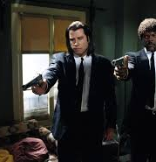

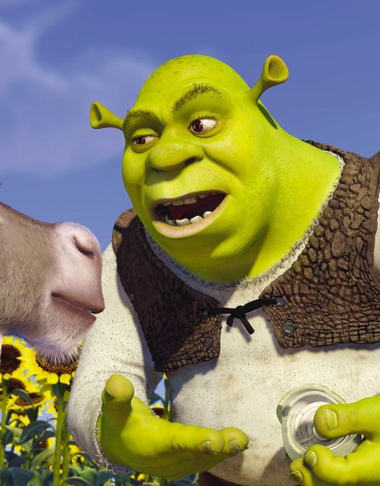

Presentation: Movie Details Fetcher
Cluanie Fraser

Slide 2
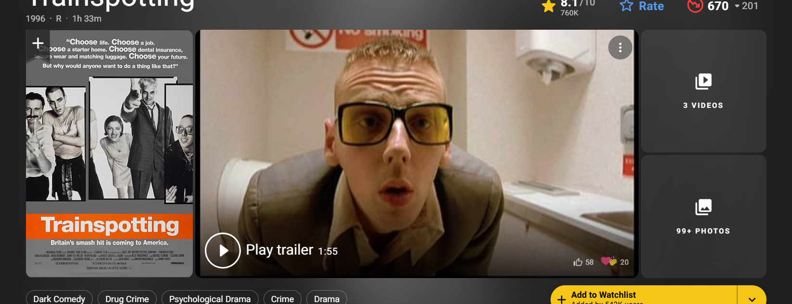
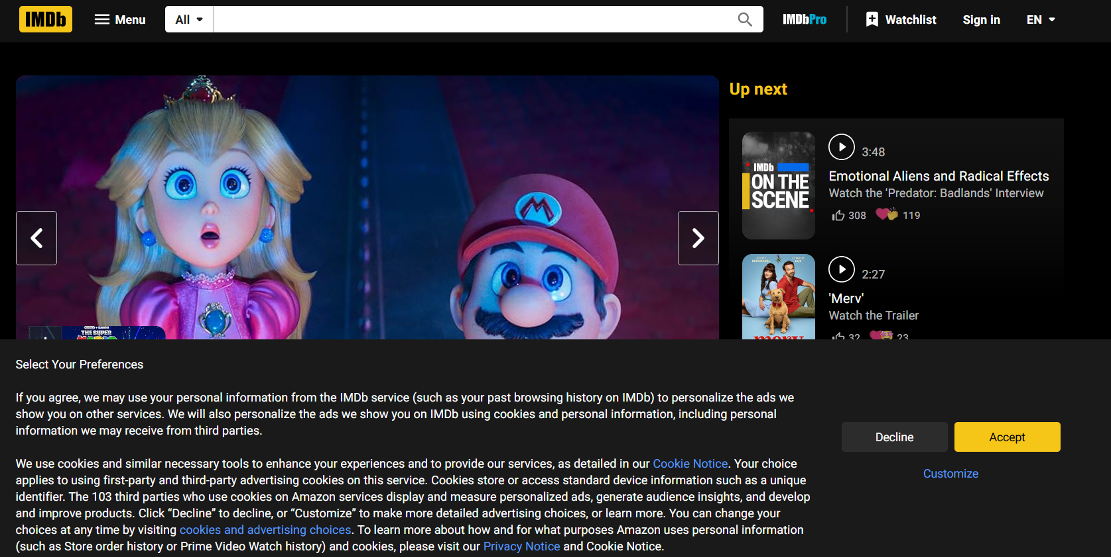
Idea
Movie review websites look terrible, cookies request every time
Desire: clean interface with only the details I want
Simple API request program now → more complex projects in future

Slide 3
Features
Search by movie title
Displays:
Rating
Release Date
Runtime
Top 5 cast members
Option to search for next movie with similar title if first incorrect

Slide 4

Target Audience
Me
Friends

Slide 5
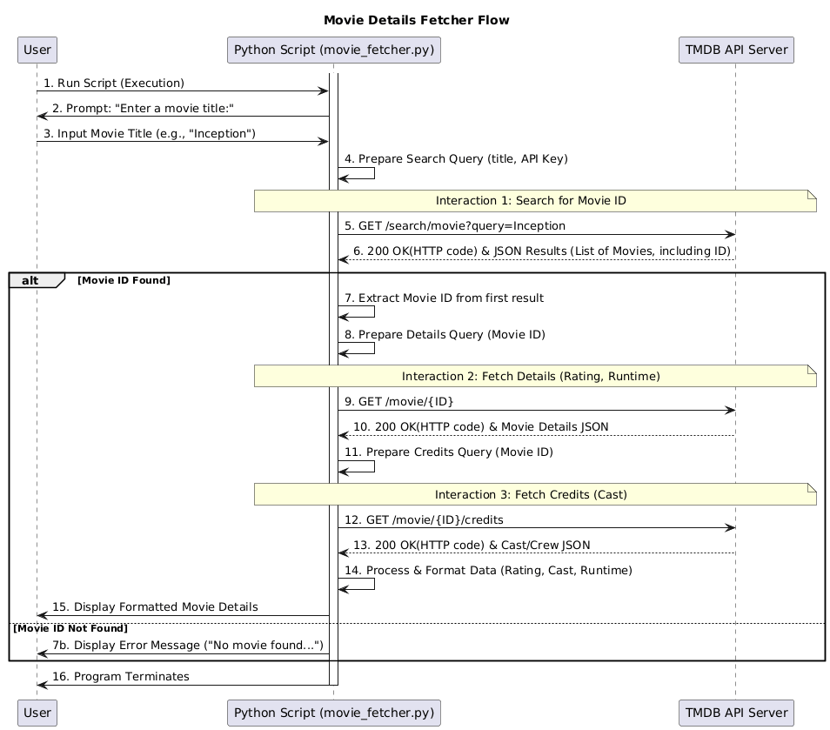
Program Structure and Flow

Slide 6
Testing Explanation
Class of 5 tests
1. Well-known movie – checking formatting and expected data
2. Partial title match
3. Non-existent movie
4. Empty string
5. Non-real dictionary index

Slide 7
Future Improvements
Implement on HTML and run on localhost
Desktop icon for ease of access

